Slide 1
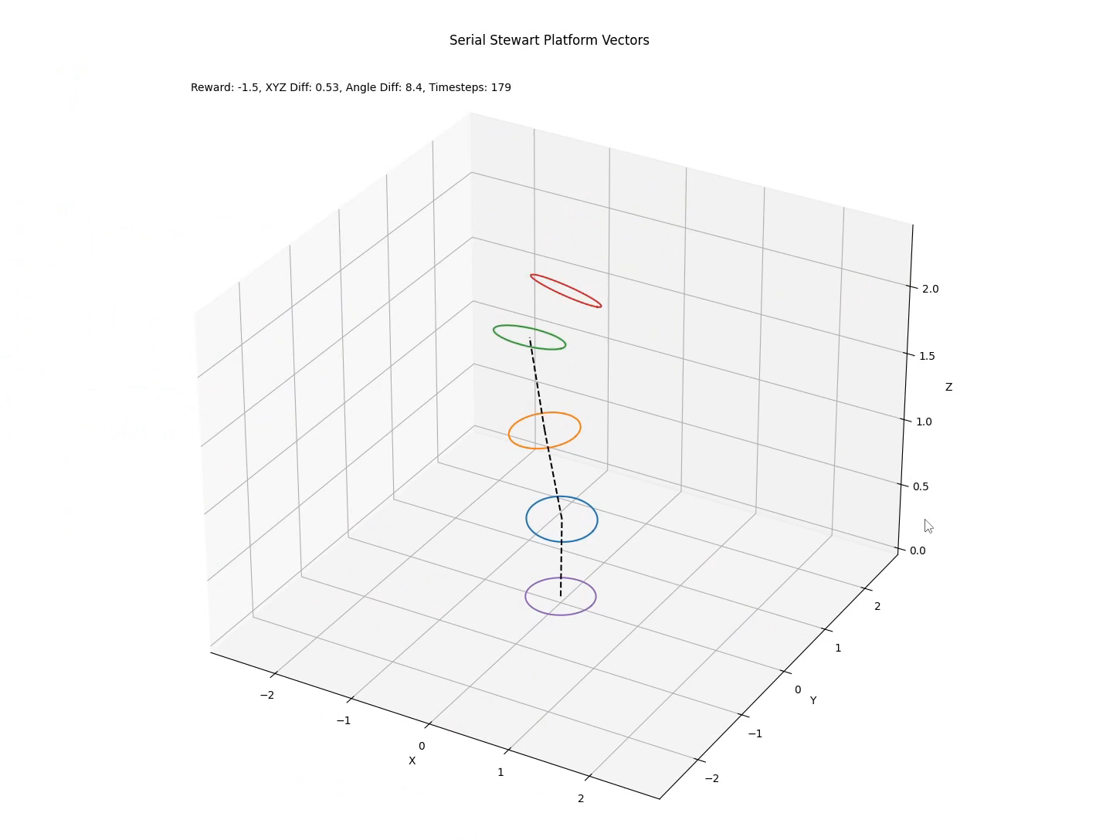
Deep RL for Serial Stewart Platform Control
Jakob Frabosilio
M.S. Mechanical Engineering
CSC 580: Intelligent Agents
Notes:
Hi, my name is Jakob, and this is my presentation on Deep Reinforcement Learning for Serial Stewart Platform Control.

Slide 2
Index
Introduction
Deep Reinforcement Learning (Deep RL)
Stewart Platforms
Simulation Environment
Neural Network Architecture
Training Results
Conclusion
References
Notes:
I’ll start with a brief introduction, followed by a basic explanation of deep reinforcement learning and PPO, which is the algorithm I chose to train my agent with. Then, I’ll explain what a Stewart platform is, and how I simulated one in Python. Lastly, we’ll explore the network architecture for the reinforcement learning agent and end by reviewing the agent’s training results.

Slide 3
Introduction
Mechanical Engineering blended graduate student
Concentrating in mechatronics and control systems
Strong mechanical and electrical design background, but weak coding and artificial intelligence background
Interested in intersection between robotics and RL
Need to design a 6DOF positioning system for thesis testing
Notes:
To introduce myself, I’m a Mechanical Engineering graduate student in the blended program here at Poly. I concentrate in mechatronics and real-time control systems and generally don’t design things that I can’t build physically, so this project has been quite a big undertaking. I’m really interested in the intersection between robotics, control systems, and reinforcement learning, ~and~ I need to design a 6 degree-of-freedom positioning system for my thesis, so this research is right up my alley.

Slide 4
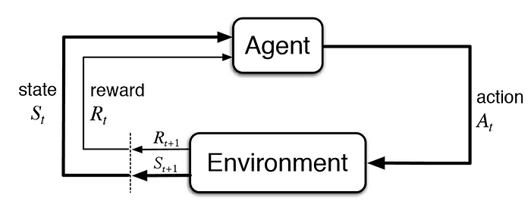
Deep Reinforcement Learning (Deep RL)
What is reinforcement learning?
Image source: [1]
Notes:
Can I have a quick show-of-hands if you’re familiar with reinforcement learning? Good, then I’ll be brief. Reinforcement learning is the process of training an agent to perform actions that maximize reward from an environment. An agent acts according to a policy, which takes an observation of the current state of the environment and returns an action.

Slide 5
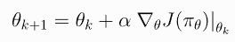
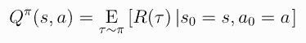
Deep Reinforcement Learning (Deep RL)
Q-learning
Policy Optimization
Discrete action space
Greedily pick action that produces highest Q-value in given state
Deep: Neural network approximates Q-value given state-action pair
Continuous or discrete action space
Modify policy to maximize expected reward, general mapping
Deep: Neural network calculates action to take based on state
Image source: [4]
Notes:
At the moment, there are two major paradigms in reinforcement learning: Q-learning and policy optimization. Q-learning works on discrete action spaces, like pressing buttons on a keyboard. Policy optimization works on discrete and continuous action spaces, like setting the length of a linear actuator. Q-learning, which you may be more familiar with, chooses the action that will produce the highest Q-value, where the Q-value is the expected reward for following a certain policy in this timestep and in every timestep beyond it. Non-deep Q-learning usually uses a lookup table, where the value of Q for given state-action pairs is saved and indexed when an action is requested. Deep Q-learning uses a neural network to approximate that lookup table, returning estimated Q-values for given state-action pairs. Policy optimization, on the other hand, modifies its policy using gradient ascent to maximize its expected reward. Whereas Q-learning is formulating explicit values for taking certain actions, policy optimization makes a more general map from state to action. Deep neural networks are used in policy optimization to approximate that map from state to action.

Slide 6
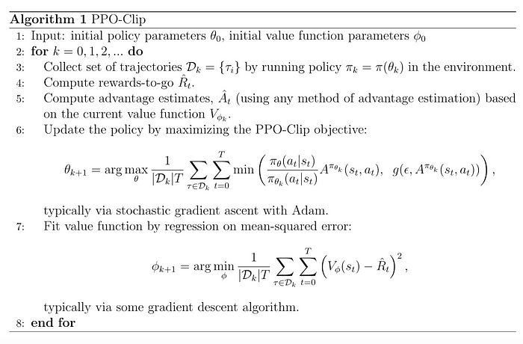
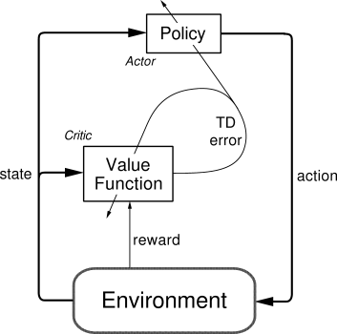
Deep Reinforcement Learning (Deep RL)
How does PPO work?
Image source: [4] [7]
Notes:
Proximal policy optimization is a type of policy optimization algorithm. It uses two neural networks, an actor and a critic, to produce an action given a state. I’m making some big oversimplifications, but PPO works like this. First, we take a bunch of actions according to some arbitrary starting policies. We calculate how many rewards we got from following those policies and use a metric called “advantage” to compare how good each policy was. Then, we update the policy parameters (the weights of the actor neural network), moving in the direction of policies that gave us a higher advantage. PPO-Clip is a variant of PPO that makes sure we take small, conservative steps – just because we get a huge reward from one policy doesn’t mean that it overrules everything else. Then, we update the value function (the weights of the critic neural network) to produce a better estimate for the value function. We repeat this process until the actor is performing as desired. Don’t get too overwhelmed by this – it’s just a way to sample a bunch of actions in different states and modify the neural network weights to make the agent get lots of rewards.

Slide 7
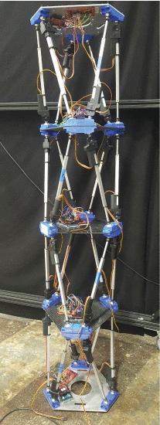
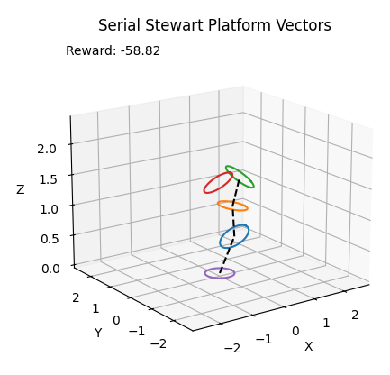
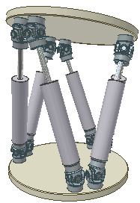
Stewart Platforms
What does Serial mean in SSP?
Image source: [8] [9]
Notes:
Onto the robotics. A Stewart platform is a type of six-degree-of-freedom actuator. It’s made of six linear actuators connected to two plates with twelve universal joints. By changing the lengths of the linear actuators, we can make the top platform move relative to the base. I don’t know about y’all, but as soon as I see a Stewart platform, my first idea is to stack them. A single Stewart platform has inverse kinematics that are well-known and solvable, but singularities can arise and oversimplifications can cause issues with performance. A stacked Stewart platform, which I’m calling a Serial Stewart Platform (or SSP for short), has much more complicated kinematics. Trying to tell that 4-stacked platform to move to a certain position and orientation would be very difficult to do deterministically. However, we can use reinforcement learning to simply “reward” the platform for going where we want it to go.

Slide 8
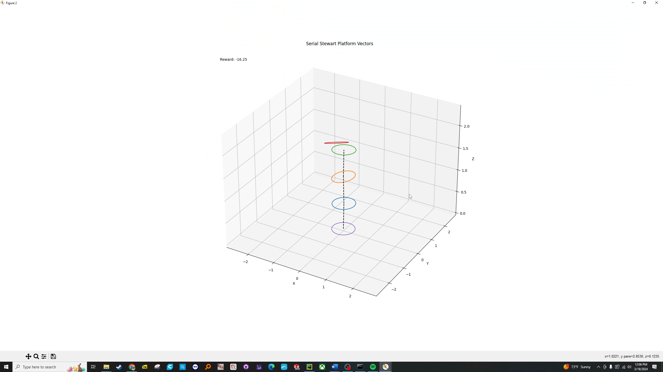
Simulation Environment
Observations:
n Position (center-to-center) vectors
n Orientation (normal-to-plane) vectors
Desired position and orientation vector
Actions:
2*n Rotation matrices applied to vectors
Notes:
Since this is my first “real” coding project, I decided to avoid closed-loop kinematics and physics simulations in lieu of a basic vector representation. I’m representing each platform using a position vector and an orientation vector. The position vector points from the center of the base of each platform to the center of the top of the platform, while the orientation vector points normal to the top plane of the platform. These two vectors fully represent a single Stewart platform. These vectors, along with a desired position and orientation for the top platform to reach, are sent to the reinforcement learning algorithm as an observation. The agent then chooses an action by generating two 3 by 3 rotation matrices for each platform, which transform the position and orientation of each platform. Of course, this isn’t how a real Stewart platform works – a real platform would probably have a similar observation space (maybe including velocity of the platforms), but the action space would be changing the length of all six linear actuators for each platform instead of applying rotation matrices.

Slide 9
Simulation Environment
Rewards:
[-] per timestep
[---] if any platform overexerted
[+++] if hits desired location and orientation
[--] proportional to distance from desired location and angle from desired orientation
Notes:
I apply a small penalty for each timestep that the agent takes, incentivizing it to converge on a solution more quickly. If any platform becomes “overexerted” – meaning that it has reached a length or angle beyond its limits – a steep penalty is applied. In the code, if the platform would overexert itself by applying a new transformation matrix, then the old position or orientation vector is used instead. If the platform reaches the desired location and orientation (within a margin of error), it gets a pretty large reward. Lastly, the agent receives a penalty proportional to the distance from the desired location and angle of the top platform. If it’s very close to being right, it’s a small penalty, but if it’s far away, it’s a large one.

Slide 10
Simulation Environment
Functions:
step(): applies actions to SSP, returns observation and reward
reset(): resets environment, initializes SSP and desired vectors
render(): visualizes environment in Matplotlib
Notes:
Within the environment, there’s three main functions. First, step takes in an action, applies the transformation matrices to the SSP, and then returns the new state of the SSP and the reward that it earned. Reset, surprisingly, resets and initializes the environment, resetting the SSP to a neutral position and generating new desired position and orientation vectors. Lastly, render visualizes the simulation using Matplotlib.

Slide 11
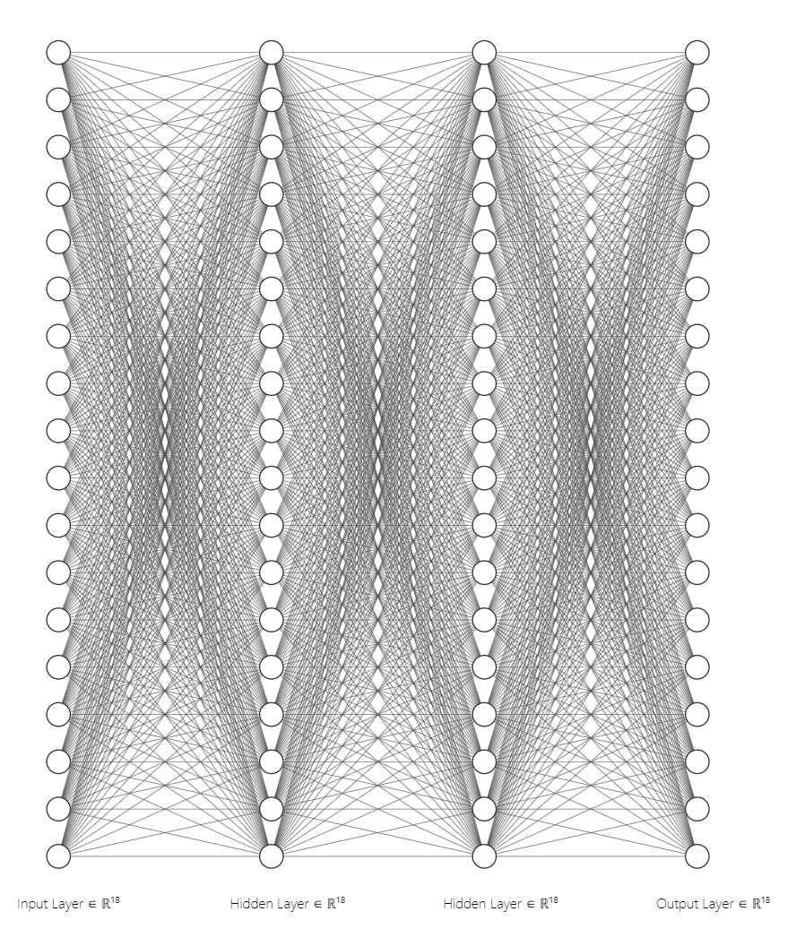
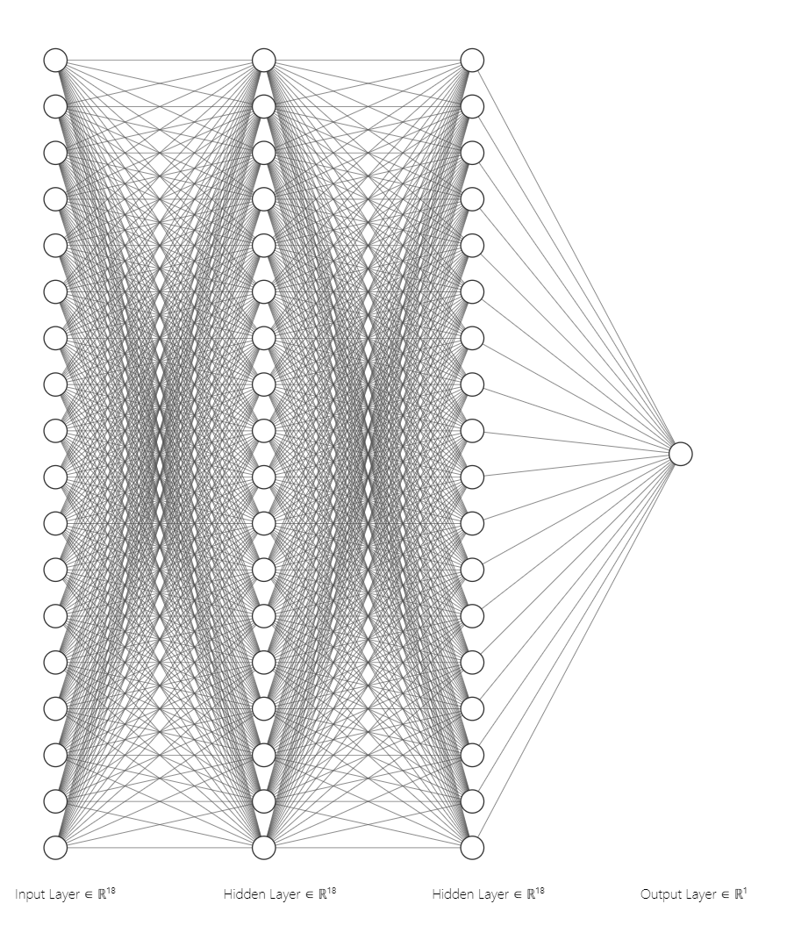
Neural Network Architecture
Actor (n=1)
Critic (n=1)
Image source: [23]
Notes:
So, we’re doing deep reinforcement learning, so there must be some neural networks involved. These are the generic architectures for the actor and critic network for a single Stewart platform. Note that the input and output layer have the same size for the actor – this is just a coincidence and it’s usually different. For the critic, the only output is the value function, so it only has one node. I chose a basic architecture of 18 nodes per platform and 2 layers based on architectures for similar reinforcement learning environments in Gymnasium, such as the LunarLander-v2 environment.

Slide 12
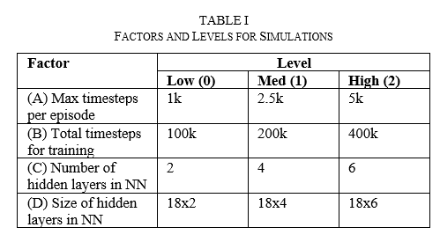
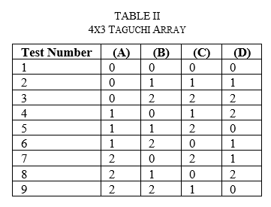
Neural Network Architecture
Notes:
…but who’s to say that this architecture is perfect? I just kinda came up with it. I’ve taken a course on neural networks before, and while there’s some guidelines to follow, most of it feels like blindly guessing and checking. So, I wanted to test a few different hyperparameters for my simulation. I’ve chosen four factors, each with three levels: the maximum number of timesteps per episode (basically forcing a reset after a certain number of steps), total timesteps for training (how long does it get trained), and the number and size of the hidden layers of the neural networks. These factors apply to both the actor and the critic network. For a factorial design, this would be a lot of tests. Thankfully, we can make use of something known as a Taguchi or orthogonal array. This array will allow us to test all of these levels together and independently in a minimum number of tests.

Slide 13
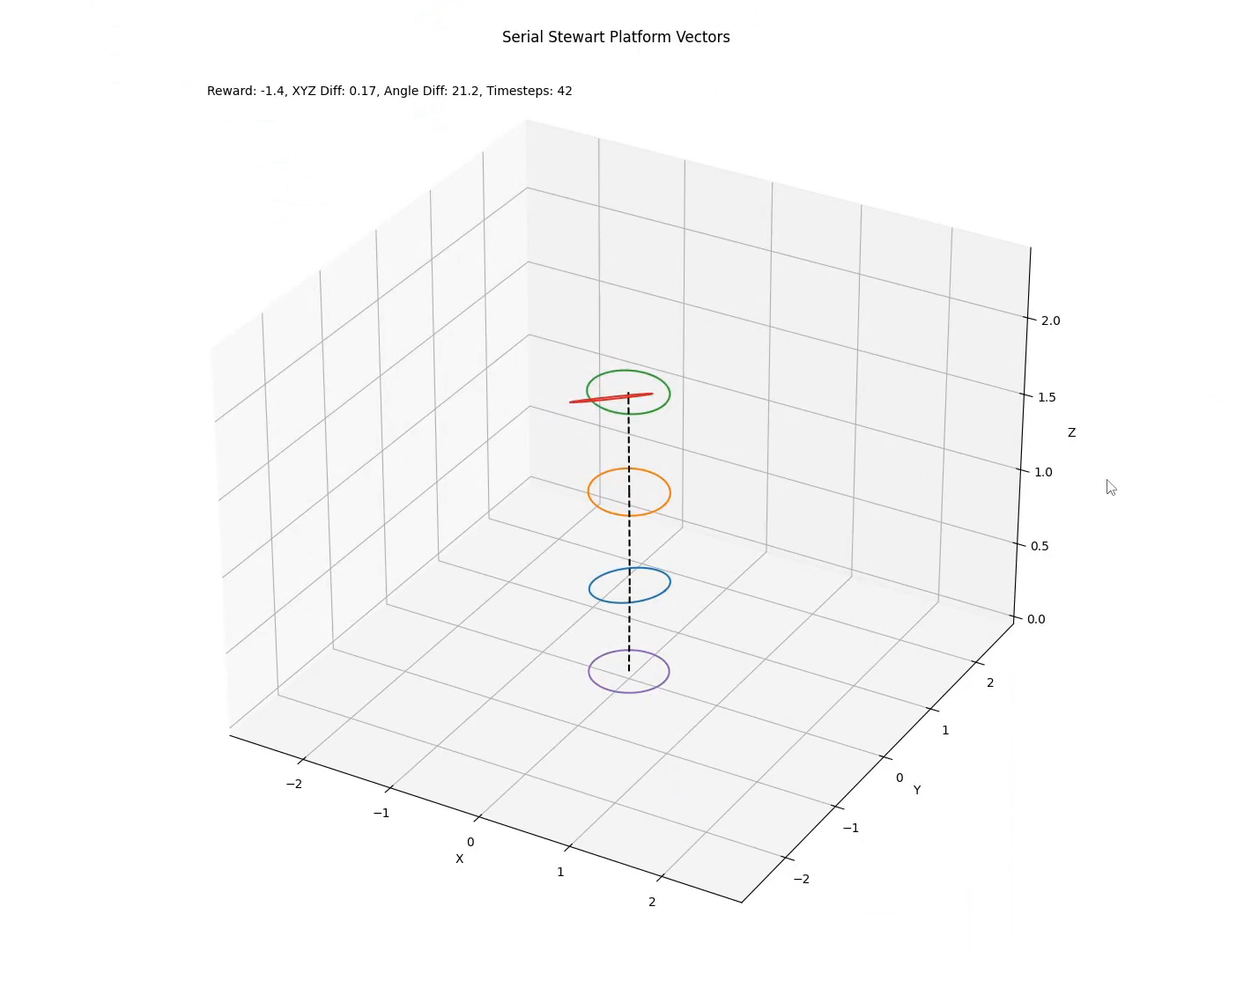
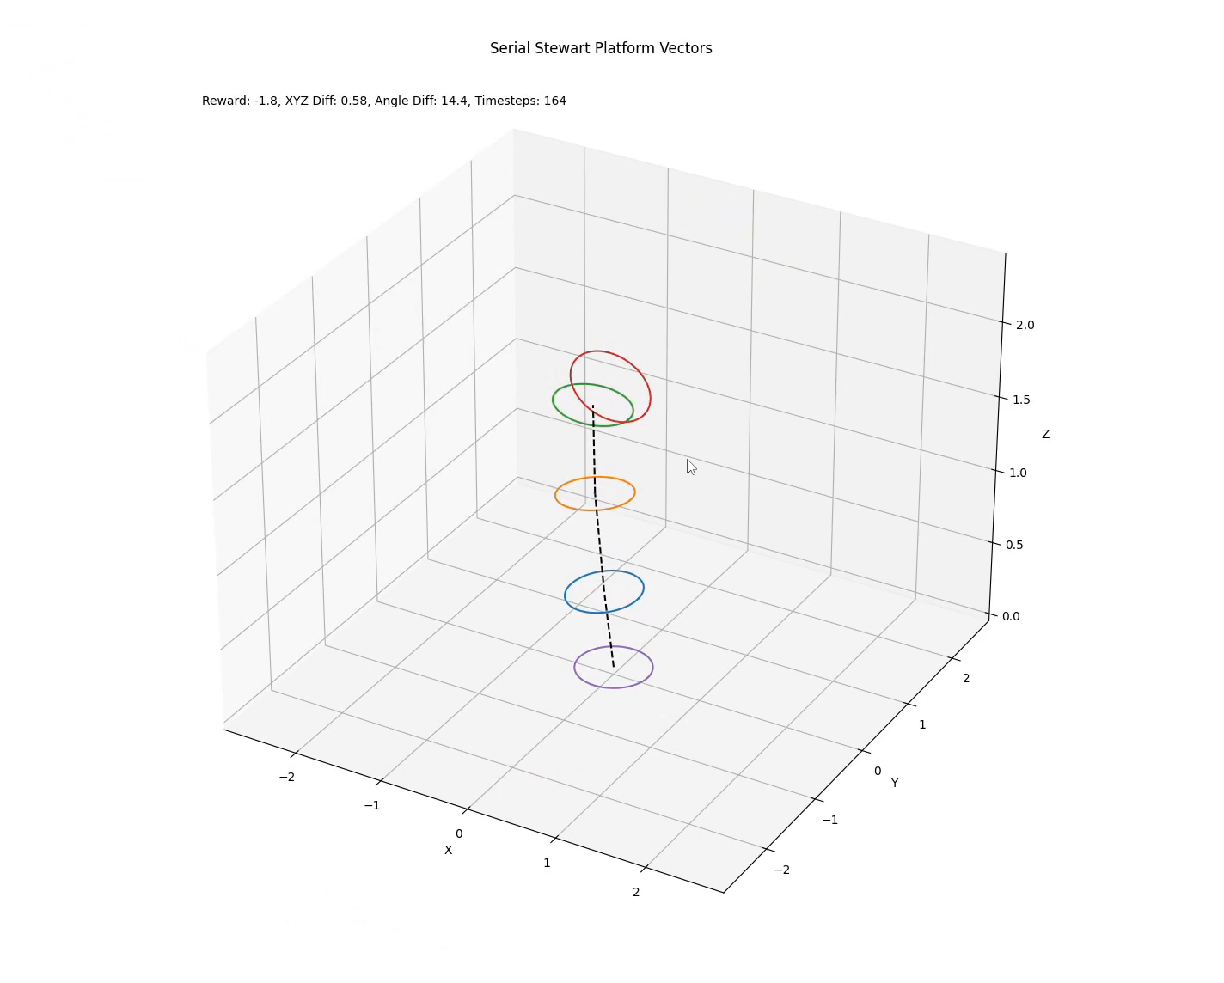
Training Results
1,000,000 timesteps 100,000 timesteps
Can you tell which is which?
Notes:
And the moment you’ve been waiting for. Here’s two videos of the agent attempting to reach its goal. Both agents are exactly the same, except one has been trained for 1 million timesteps and the other for only 100,000. Can you tell which is which? Show of hands, who thinks the one on the left is the 1 million one? Who thinks it’s the one on the right? Okay, let’s see. Both agents started with a different goal, which may have skewed the results, but it’s not an astonishing difference. Let’s figure out why.

Slide 14
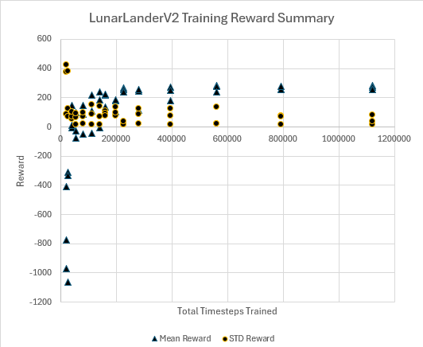
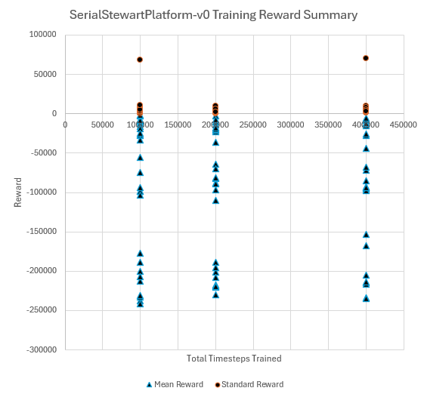
Training Results
LunarLander-v2
SerialStewartPlatform-v0
Notes:
Before simulating my custom environment, I wanted to have a baseline to compare it to. LunarLander-v2 is an environment included with Stable Baselines3 that simulates a small lunar lander with three thrusters landing on a 2d surface of the moon. You can see that as we increase the number of timesteps, the reward begins to converge on certain values – training for 1.2 million steps isn’t any better than training for 800 thousand. How come we don’t see the same thing with the custom environment?

Slide 15
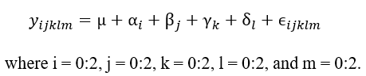
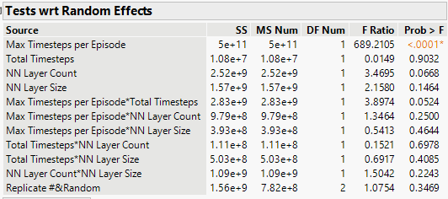
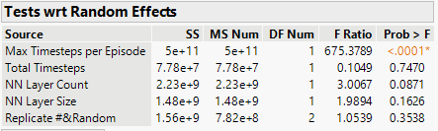
Training Results
Initial model (no interactions)
Second model (2-way interactions)
Notes:
In order to figure out what’s going on, I applied a multivariate model to the test data. I’m assuming that each simulation’s reward can be described as a sum of some grand mean (the overall average reward of every simulation), plus a number of effects that we specified earlier (on the top right of this slide). If you don’t have a strong statistics background, that’s okay, we’re going to breeze through this. Fitting the model without considering any interactions, we see that only one of the factors has a meaningful impact on the reward for a simulation: the number of max timesteps per episode. The number of timesteps an agent is trained for, at least for the range I specified, is actually the least contributing factor! Next, I ran a model that considered all two-way interactions – i.e., does a certain combination of total timesteps and layer size make a difference? We see that none of the results beat our significance level of 5%, but the interaction between the max timesteps per episode and the max number of timesteps is very close.

Slide 16
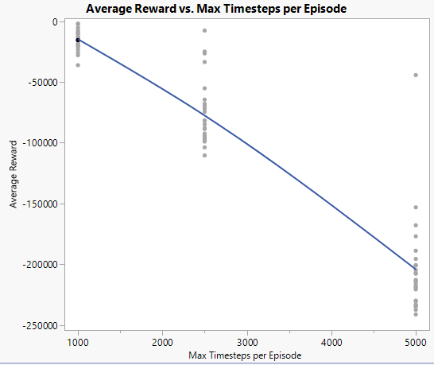
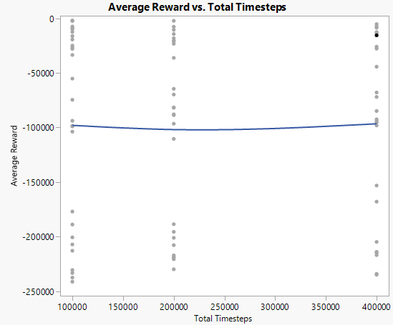
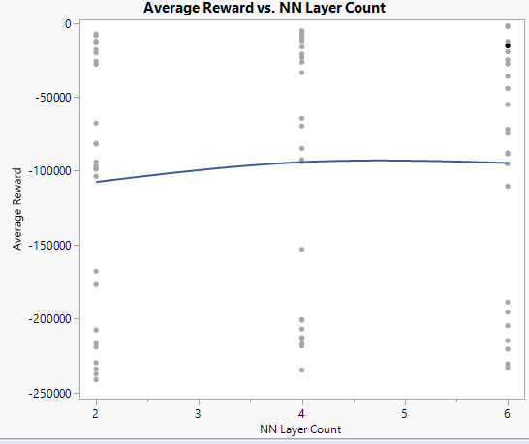
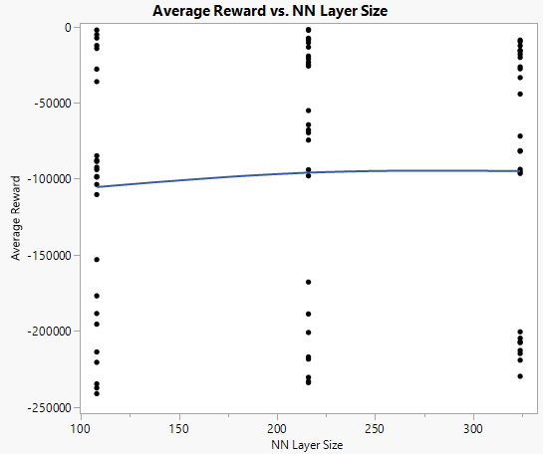
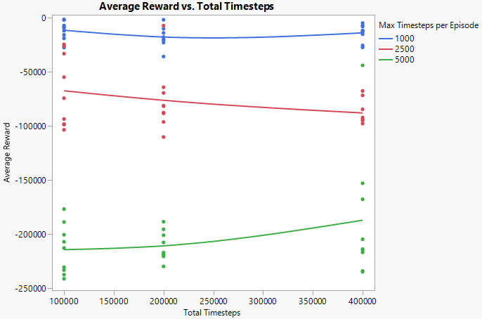
Training Results
Notes:
Here’s a few graphical representations of the test data. You can see that the average reward is strongly correlated to the max timesteps per episode, while it doesn’t even appear to change for the other three factors. On the bottom right, we have the total timesteps but this time grouped by the max number of timesteps per episode. Here, we see that the individual groups appear to follow weak trends, as our effects tests predicted.

Slide 17
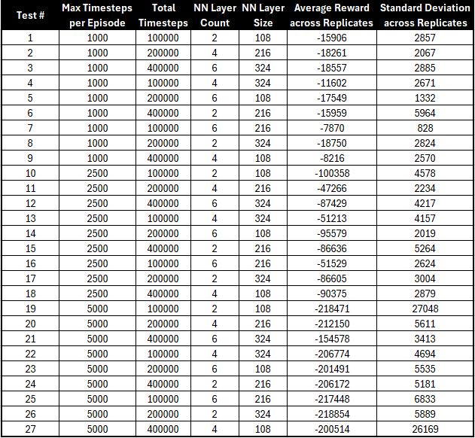
Training Results
Notes:
Looking over the results, it appears that the most important factors are the max timesteps per episode and the interaction between max timesteps per episode and total timesteps. I’ve included a table summarizing the tests. In total, I trained 81 individual models, as each test has three replicates.

Slide 18
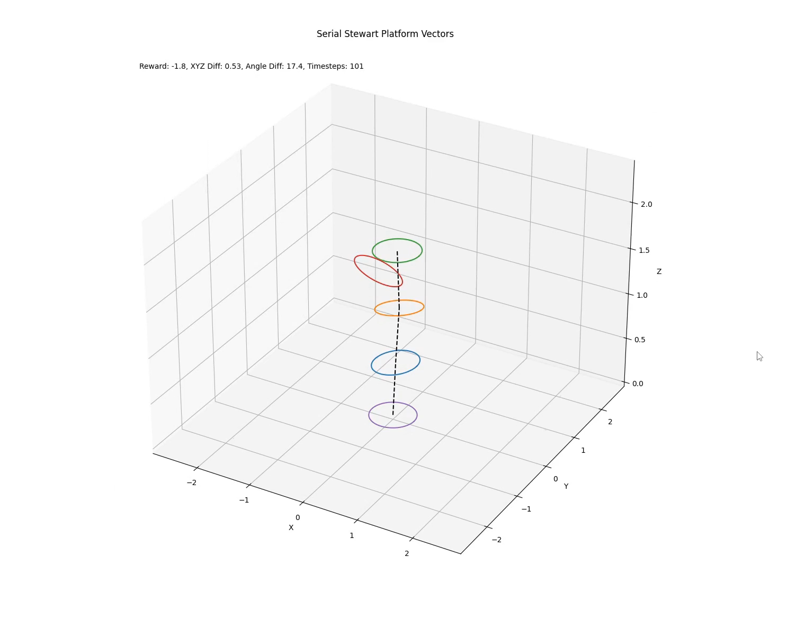
Training Results
Optimized, 2 million Unoptimized, 30 million
Does the optimization make a difference?
Notes:
So great, what does that all mean? It means we now know which direction to head in to improve our model. I trained one last model using the following parameters: max timesteps per episode of 750, 2 million timesteps, and 6 hidden layers with 216 nodes each. The other model is a random model from the earlier tests. Can you tell which is which?

Slide 19
Conclusion
Future work:
Simulate in physics engine like MuJoCo, Drake, Gazebo
Design and build small, modular Stewart platform
Train physical SSP in real-time (supplemented by simulation data)
Use SSP as 6DOF positioner for Master’s thesis testing
Notes:
So, it’s not perfect, but it’s definitely better than my first attempt. I believe the largest source of error is how I’m handling the “overexertion” of the platforms. Instead of applying a large negative reward for overextension, I should just restrict it from being able to overexert at all! The easiest way to do this would be to use a physics engine that can handle closed-loop kinematics; the three listed here would all work, and I even found a Stewart platform model in Gazebo. However, these engines have a much steeper learning curve than Stable Baselines3 and Gymnasium. My end goal is to build a real-life SSP out of modular platforms, and depending on the complexity of implementing those physics engines, I may skip straight to training on a physical SSP. If I can get the simulations working, then I plan to pre-train a model in the physics engine to get it 90% of the way there, then to finish the rest of the training in real-time. I have lots of experience writing for real-time operating systems and microcontrollers, and now that I know the format for reinforcement learning environments in Gymnasium, it’ll be relatively straightforward to make a real-life reinforcement learning environment.

Slide 20
Conclusion
Wrote and simulated my own deep RL environment
Understood basics of how deep RL and PPO work
Applied design-of-experiment skills to practical project
Coded a large, non-RTOS project for the first time
Learned importance of a good reward function
Had fun!
Notes:
In conclusion, I wrote and simulated my own deep reinforcement learning environment using Stable Baselines3 and Gymnasium, learned the basics of deep RL and PPO, got to apply some statistics tools to a practical project, coded my first real non-RTOS/microcontroller project, and learned the importance of having a good reward function. And even though I’ve hit lots of speedbumps in this class, I still had fun along the way and enjoyed performing this research!

Slide 21
References
S. Bhatt, “Reinforcement Learning 101,” Medium, Mar 19, 2018. [Online]. Available: https://towardsdatascience.com/reinforcement-learning-101-e24b50e1d292. Accessed: Mar 19, 2024.
W. Ertel, Introduction to Artificial Intelligence, 2nd ed. Cham, Switzerland: Springer Nature, 2017, doi: 10.1007/978-3-319-58487-4.
V. Mnih, K. Kavukcuoglu, D. Silver, et al, “Human-level control through deep reinforcement learning,” Nature, no. 518, pp. 529-533, Feb 25, 2015. [Online]. Available: https://www.nature.com/articles/nature14236. Accessed: Mar 19, 2024.
OpenAI, Spinning Up, 2024. [Online]. Available: https://spinningup.openai.com/en/latest/. Accessed: Mar 19, 2024.
J. Liu, “DQN vs PPO. Discussion with my mentors,” jerrickliu.com, May 3, 2021. [Online]. Available: https://jerrickliu.com/2020-07-13-FourthPost/. Accessed: Mar 19, 2024.
E. Yu, “Coding PPO from Scratch with PyTorch (Part 1/4),” Medium, Sep 17, 2020. [Online]. Available: https://medium.com/analytics-vidhya/coding-ppo-from-scratch-with-pytorch-part-1-4-613dfc1b14c8. Accessed: Mar 19, 2024.
R. Sutton, A. Barto, “Actor-Critic Methods” in Reinforcement Learning: An Introduction, Cambridge, Massachusetts, United States: The MIT Press, 2005, ch. 6, sec. 6. [Online]. Available: http://incompleteideas.net/book/first/ebook/node66.html. Accessed: Mar 19, 2024.
“Stewart platform,” Wikipedia, Oct 24, 2023. [Online]. Available: https://en.wikipedia.org/wiki/Stewart_platform. Accessed: Mar 19, 2024
D. Balaban, J. Cooper and E. Komendera, "Inverse Kinematics and Sensitivity Minimization of an n-Stack Stewart Platform," 2019 IEEE/RSJ International Conference on Intelligent Robots and Systems (IROS), Macau, China, 2019, pp. 6794-6799, doi: 10.1109/IROS40897.2019.8968190.
H. Yadavari, V. Tavakol Aghaei, and S. Ikizoglu, "Addressing Challenges in Dynamic Modeling of Stewart Platform using Reinforcement Learning-Based Control Approach," J. Robotics Control (JRC), vol. 5, 2024, Art. no. 20582. doi: 10.18196/jrc.v5i1.20582.
A. Raffin, Stable Baselines3, 2024. [Online]. Available: https://stable-baselines3.readthedocs.io/en/master/. Accessed: Mar 19, 2024.
Farama Foundation, “Gymnasium,” 2024. [Online]. Available: https://gymnasium.farama.org/index.html. Accessed: Mar 19, 2024.
J. Frabosilio, “SB3-PPO-Test,” GitHub, 2024. [Online]. Available: https://github.com/jfrabosi/SB3-PPO-Test,
“Angle between Two Vectors Formula”, GeeksForGeeks, Feb 4, 2024. [Online]. Available: https://www.geeksforgeeks.org/angle-between-two-vectors-formula/. Accessed: Mar 19, 2024.
“Matplotlib,” matplotlib.org, 2024. [Online]. Available: https://matplotlib.org/. Accessed: Mar 19, 2024.
“Make your own custom environment,” Gym, 2024. [Online]. Available: https://www.gymlibrary.dev/content/environment_creation/. Accessed: Mar 19, 2024.
“MuJoCo,” mujoco.org, 2024. [Online]. Available: https://mujoco.org/. Accessed: Mar 19, 2024. Accessed: Mar 19, 2024
R. N. Kacker, E. S. Lagergren, and J. J. Filliben, "Taguchi's Orthogonal Arrays Are Classical Designs of Experiments," J. Res. Natl. Inst. Stand. Technol., vol. 96, no. 5, pp. 577–591, 1991. doi: 10.6028/jres.096.034.
“Gazebo,” gazebosim.org, 2024. [Online]. Available: https://gazebosim.org/home. Accessed: Mar 19, 2024.
D. Ingram, “Stewart,” GitHub, 2018. [Online]. Available: https://github.com/daniel-s-ingram/stewart. Accessed: Mar 19, 2024.
T. Vandermeer, “Hospitalbot path planning,” GitHub, 2023. Available: https://github.com/TommasoVandermeer/Hospitalbot-Path-Planning/tree/humble. Accessed: Mar 19, 2024.
G. Oehlert, A First Course in Design and Analysis of Experiments. New York, New York, United States: W. H. Freemen and Company.
A. Lenail, “NN-SVG,” alexlenail.me, 2024. [Online]. Available: https://alexlenail.me/NN-SVG/index.html. Accessed: Mar 19, 2024.

Slide 22
Questions?

